Slide 1

Student Data Analysis (EDA)
Sayan karmakar
Last update = 22/12/2022

Slide 2
Questions We Asked.
1. Short students as per there gender.
2.Students lunch report.
3.Short students by race.
4.Exam preparation course taken by students.
5.Results of test preparation course.
6.Analysing lunch.
7.Analysing Parental Level of Education.

Slide 3
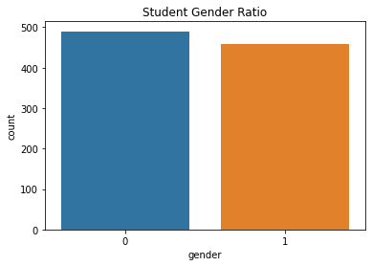
Short students as per there gender.
From this analysis we found that Girls(0) students are 490 and Boys(1) students are 459.

Slide 4
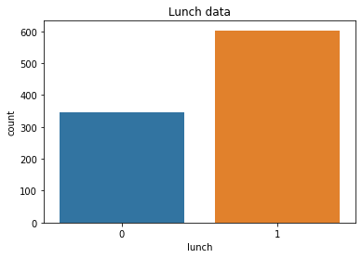
Students lunch report.
We can see that students prefer Home or Standard Lunch more than Free Lunch that provided by the school.
0 = Free Lunch
1 = Standard Lunch

Slide 5
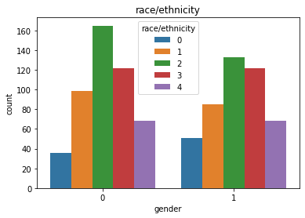
Short students by race.
From this analysis we found that Girls(0) and Boys(1) Race/ethnicity.
0 = group A
1 = group B
2 = group C
3 = group D
4 = group E

Slide 6
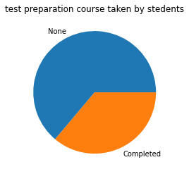
Exam preparation course taken by students.
We can see that not every students are taking the exam preparation course.

Slide 7
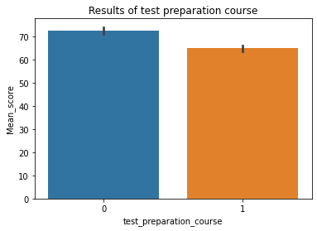
Results of test preparation course.
We can see that students who take Exam Preparation Course there results are better then others.

Slide 8
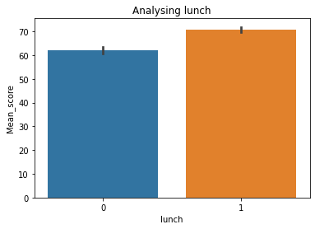
Analysing lunch.
We can see that students who take Lunch from there home they have better Mean Score then others.

Slide 9
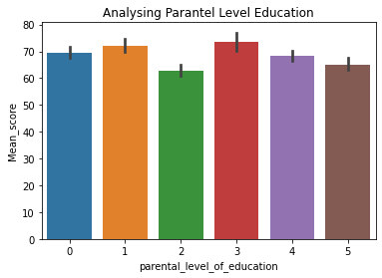
Analysing Parental Level of Education.
We can see that Parental Level of education have influence on student results.
0 = Associate's degree
1 = Bachelor's degree
2 = High school
3 = Master's degree
4 = Some college
5 = Some high school

